Slide 1

Heaps
Heap as a Data Structure
Types of heap – Min heap and Max heap
Operations on Heap
Heap Sort
Applications of Heap

Slide 2
The Heap Data Structure
Def: A max (min) heap is a tree in which the key value in each node is no smaller (larger) than the key values in its children (if any).
A max heap is a complete binary tree that is also a max tree.
A min heap is a complete binary tree that is also a min tree.
Order (heap) property: for any node x (for Max heap)
Parent(x) ≥ x
8
Example of Max heap
“The root is the maximum
element of the heap!”
7
4
5
2
A heap is a binary tree that is filled in order
Heap

Slide 3
The heap property (for Max heap)
A node has the heap property if the value in the node is as large as or larger than the values in its children
12
12
12
8
3
8
12
8
14
Blue node has heap property
Blue node has heap property
Blue node does not have heap property
All leaf nodes automatically have the heap property
A binary tree is a heap if all nodes in it have the heap property

Slide 4
Types of Heap
Min-heap
Max-heap

Slide 5
Min Heap
Data
all >= Data
all >= Data
In min-heap, the key value of each node is lesser than or equal to the key value of its children
In addition, every path from root to leaf should be sorted in ascending order

Slide 6
Max Heap
Data
all <= Data
all <= Data
A max-heap is where the key value of a node is greater than the key values in of its children

Slide 7
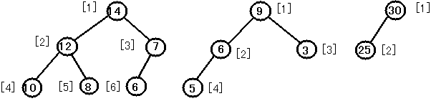
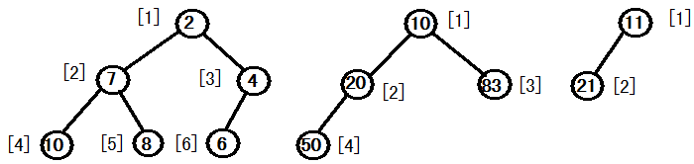
Example of Heap
Max-Heap
Min-Heap

Slide 8
Mapping into an array
25
22
17
19
22
14
15
18
14
21
3
9
11
0 1 2 3 4 5 6 7 8 9 10 11 12
25
22
17
19
22
14
15
18
14
21
3
9
11
Notice:
The left child of index i is at index 2*i+1(index starting from 0)
The right child of index i is at index 2*i+2
Example: the children of node value (19) [index 3 ] are at [index 7] (18) and [index 8] (14)

Slide 9
Operations on Heaps
Create—To create an empty heap to which ‘root’ points
Insert—To insert an element into the heap
Delete—To delete max (or min) element from the heap
ReheapUp—To rebuild heap when we use the insert() function
ReheapDown—To build heap when we use the delete() function

Slide 10
Constructing a (max) heap
A tree consisting of a single node is automatically a heap
We construct a heap by adding nodes one at a time:
Add the node just to the right of the rightmost node in the deepest level
If the deepest level is full, start a new level
Examples:
Add a new node here
Add a new node here

Slide 11
Constructing a (max)heap contd…
Each time we add a node, we may destroy the heap property of its parent node
To fix this, we shift up
But each time we shift up, the value of the topmost node in the shift may increase, and this may destroy the heap property of its parent node
We repeat the shifting up process, moving up in the tree, until either
We reach nodes whose values don’t need to be swapped (because the parent is still larger than both children), or
We reach the root

Slide 12
Constructing a heap contd…
8
8
10
10
10
8
8
5
1
2
3
10
12
10
12
5
10
5
8
5
8
8
12
4

Slide 13
Other children are not affected
12
12
14
10
5
14
5
12
5
8
14
8
10
8
10
The node containing 8 is not affected because its parent gets larger, not smaller
The node containing 5 is not affected because its parent gets larger, not smaller
The node containing 8 is still not affected because, although its parent got smaller, its parent is still greater than it was originally

Slide 14
A sample heap
Here’s a sample binary tree after it has been heapified
25
22
17
19
22
14
15
18
14
21
3
9
11
Notice that heapified does not mean sorted
Heapifying does not change the shape of the binary tree; this binary tree is balanced and left-justified because it started out that way

Slide 15
Insert (max heap)
insert(22)
20
20
14
15
14
15
7
6
10
8
7
6
10
8
1
3
4
5
2
1
3
4
5
2
22
Notes:
Inserting works similarly. We tack a hole on at the end of the tree, and move that hole _up_ until it’s in the right place for the new value.

Slide 16
Insert (max heap) contd…
20
20
14
15
14
22
7
6
22
8
7
6
15
8
1
3
4
5
2
10
1
3
4
5
2
10
22
14
20
7
6
15
8
1
3
4
5
2
10

Slide 17
Algorithm Insert(a,n)
{
i=n; elem=a[n-1];
if(i!=1){
while((i>0)&&(a[(i/2)-1]<elem){
a[i-1]=a[(i/2)-1];
i=(i/2);
}
a[i-1]=elem;
return true;
}
}
Algorithm add()
{ //index of a starting from 0
j=0 ; a[20];
Get Choice
Repeat
{
a[j]=elem;
insert(a,j+1);
j++;
} until(choice==‘n’);
}
20
14
15
7
6
10
8
1
3
4
5
2
22

Slide 18
Algorithm Insert(a,n)
{
i=n; elem=a[n-1];
if(i!=1){
while((i>0)&&(a[(i/2)-1]<elem){
a[i-1]=a[(i/2)-1];
i=(i/2);
}
a[i-1]=elem;
return true;
}
}
Algorithm add()
{ //index of a starting from 0
j=0 ; a[20];
Get Choice
Repeat
{
a[j]=elem;
insert(a,j+1);
j++;
} until(choice==‘n’);
}
20
14
15
7
6
10
8
1
3
4
5
2
10
elem = 22

Slide 19
Algorithm Insert(a,n)
{
i=n; elem=a[n-1];
if(i!=1){
while((i>0)&&(a[(i/2)-1]<elem){
a[i-1]=a[(i/2)-1];
i=(i/2);
}
a[i-1]=elem;
return true;
}
}
Algorithm add()
{ //index of a starting from 0
j=0 ; a[20];
Get Choice
Repeat
{
a[j]=elem;
insert(a,j+1);
j++;
} until(choice==‘n’);
}
20
14
15
7
6
15
8
1
3
4
5
2
10
elem = 22

Slide 20
Algorithm Insert(a,n)
{
i=n; elem=a[n-1];
if(i!=1){
while((i>0)&&(a[(i/2)-1]<elem){
a[i-1]=a[(i/2)-1];
i=(i/2);
}
a[i-1]=elem;
return true;
}
}
Algorithm add()
{ //index of a starting from 0
j=0 ; a[20];
Get Choice
Repeat
{
a[j]=elem;
insert(a,j+1);
j++;
} until(choice==‘n’);
}
20
14
20
7
6
15
8
elem = 22
1
3
4
5
2
10

Slide 21
Algorithm Insert(a,n)
{
i=n; elem=a[n-1];
if(i!=1){
while((i>0)&&(a[(i/2)-1]<elem){
a[i-1]=a[(i/2)-1];
i=(i/2);
}
a[i-1]=elem;
return true;
}
}
Algorithm add()
{ //index of a starting from 0
j=0 ; a[20];
Get Choice
Repeat
{
a[j]=elem;
insert(a,j+1);
j++;
} until(choice==‘n’);
}
22
14
20
7
6
15
8
1
3
4
5
2
10

Slide 22
DeleteMax
pqueue.deleteMax()
22
8
10
15
10
15
7
6
10
9
7
6
10
9
4
5
2
1
8
4
5
2
1
22
Notes:
OK, to delete, we start by plucking out that value in O(1) time.
Now, we have a hole at the top, and a node that isn’t proper for a complete tree at the bottom.
So, we fix it by putting the value in the hole, and moving the hole until we restore the heap-order property.

Slide 23
DeleteMax
pqueue.deleteMax()
15
8
10
8
10
15
7
6
10
9
7
6
10
9
4
5
2
1
4
5
2
1
15
15
10
10
10
8
7
6
8
9
7
6
10
9
4
5
2
1
4
5
2
1
Notes:
OK, to delete, we start by plucking out that value in O(1) time.
Now, we have a hole at the top, and a node that isn’t proper for a complete tree at the bottom.
So, we fix it by putting the value in the hole, and moving the hole until we restore the heap-order property.

Slide 24
DeleteMax (Final)
pqueue.deleteMax()
15
10
10
7
6
8
9
4
5
2
1
Notes:
OK, to delete, we start by plucking out that value in O(1) time.
Now, we have a hole at the top, and a node that isn’t proper for a complete tree at the bottom.
So, we fix it by putting the value in the hole, and moving the hole until we restore the heap-order property.

Slide 25
Delete (Max) element Algorithm(index starting from 0)
Algorithm Deleteheap(a,n) //n are the no. of elements in array
{
// Interchange the maximum with the element at the end of array
repeat{
t=a[0];
a[0]=a[n-1] ;
a[n-1]=t;
n --;
Adjust(a, n-1, 0);
accept choice
}until(choice=‘y’);
}
Algorithm Adjust(a,n,i)
{
while(2*i+1<=n) do
{
j=2*i+1; //index of left child
// compare left and right child and let j be the larger child
if((j+1 <= n) and (a[j+1] > a[j]))
j=j+1
If a[i] >= a[j])
then break; //if parent > children then break
else
{
//swap a[i] with a[j]
temp=a[i]; a[i]=a[j]; a[j]=temp;
i=j;
}
} //end of while
}
8
10
15
7
6
10
9
4
5
2
1
22

Slide 26
Delete (Max) element Algorithm(index starting from 0)
Algorithm Deleteheap(a,n) //n are the no. of elements in array
{
// Interchange the maximum with the element at the end of array
repeat{
t=a[0];
a[0]=a[n-1] ;
a[n-1]=t;
n --;
Adjust(a, n-1, 0);
accept choice
}until(choice=‘y’);
}
Algorithm Adjust(a,n,i)
{
while(2*i+1<=n) do
{
j=2*i+1; //index of left child
// compare left and right child and let j be the larger child
if((j+1 <= n) and (a[j+1] > a[j]))
j=j+1
If a[i] >= a[j])
then break; //if parent > children then break
else
{
//swap a[i] with a[j]
temp=a[i]; a[i]=a[j]; a[j]=temp;
i=j;
}
} //end of while
}
8
10
15
7
6
10
9
4
5
2
1

Slide 27
Delete (Max) element Algorithm(index starting from 0)
Algorithm Deleteheap(a,n) //n are the no. of elements in array
{
// Interchange the maximum with the element at the end of array
repeat{
t=a[0];
a[0]=a[n-1] ;
a[n-1]=t;
n --;
Adjust(a, n-1, 0);
accept choice
}until(choice=‘y’);
}
Algorithm Adjust(a,n,i)
{
while(2*i+1<=n) do
{
j=2*i+1; //index of left child
// compare left and right child and let j be the larger child
if((j+1 <= n) and (a[j+1] > a[j]))
j=j+1
If a[i] >= a[j])
then break; //if parent > children then break
else
{
//swap a[i] with a[j]
temp=a[i]; a[i]=a[j]; a[j]=temp;
i=j;
}
} //end of while
}
15
10
8
7
6
10
9
4
5
2
1

Slide 28
Delete (Max) element Algorithm(index starting from 0)
Algorithm Deleteheap(a,n) //n are the no. of elements in array
{
// Interchange the maximum with the element at the end of array
repeat{
t=a[0];
a[0]=a[n-1] ;
a[n-1]=t;
n --;
Adjust(a, n-1, 0);
accept choice
}until(choice=‘y’);
}
Algorithm Adjust(a,n,i)
{
while(2*i+1<=n) do
{
j=2*i+1; //index of left child
// compare left and right child and let j be the larger child
if((j+1 <= n) and (a[j+1] > a[j]))
j=j+1
If a[i] >= a[j])
then break; //if parent > children then break
else
{
//swap a[i] with a[j]
temp=a[i]; a[i]=a[j]; a[j]=temp;
i=j;
}
} //end of while
}
15
10
8
7
6
10
9
4
5
2
1

Slide 29
Delete (Max) element Algorithm(index starting from 0)
Algorithm Deleteheap(a,n) //n are the no. of elements in array
{
// Interchange the maximum with the element at the end of array
repeat{
t=a[0];
a[0]=a[n-1] ;
a[n-1]=t;
n --;
Adjust(a, n-1, 0);
accept choice
}until(choice=‘y’);
}
Algorithm Adjust(a,n,i)
{
while(2*i+1<=n) do
{
j=2*i+1; //index of left child
// compare left and right child and let j be the larger child
if((j+1 <= n) and (a[j+1] > a[j]))
j=j+1
If a[i] >= a[j])
then break; //if parent > children then break
else
{
//swap a[i] with a[j]
temp=a[i]; a[i]=a[j]; a[j]=temp;
i=j;
}
} //end of while
}
15
10
10
7
6
8
9
4
5
2
1

Slide 30
Sorting
Other than as a priority queue, the heap has one other important usage: heap sort
Heap sort is one of the fastest sorting algorithms, achieving speed as that of the quicksort and merge sort algorithms
The advantages of heap sort are that it does not use recursion and it is efficient for any data order
There is no worse-case scenario in the case of heap sort

Slide 31
Heap Sort
Steps for heap sort (ascending order) are as follows:
Build the heap tree(for given array as it may not be in heap tree form)
Start Delete Heap operations, storing each deleted element at the end of the heap array
After performing step 2, again adjust the heap tree (ReHeapDown)
Repeat step 2 and 3 for n-1 times to sort the complete array

Slide 32
Sample Run
Start with unordered array of data
Array representation:
Binary tree representation:
21 | 15 | 25 | 3 | 5 | 12 | 7 | 19 | 45 | 2 | 9
21
15
25
3
5
12
7
19
45
2
9

Slide 33
Sample Run
Heapify the binary tree –(from (n/2)-1 to 0)
21
21
21
15
25
15
25
15
25
3
5
12
7
3
9
12
7
45
9
12
7
19
45
2
9
19
45
2
5
19
3
2
5
45
21
21
21
25
45
25
45
25
19
9
12
7
19
9
12
7
19
9
12
7
15
3
2
5
15
3
2
5
15
3
2
5

Slide 34
Step 2 – perform n – 1 deleteMax(es) and replace last element in heap with first, then re-heapify. Place deleted element in the last node’s position.
45
25
21
25
21
12
19
9
12
7
19
9
5
7
15
3
2
5
15
3
2
45 | 21 | 25 | 19 | 9 | 12 | 7 | 15 | 3 | 2 | 5
25 | 21 | 12 | 19 | 9 | 5 | 7 | 15 | 3 | 2 | 45
25
21
21
12
19
12
19
9
5
7
15
9
5
7
15
3
2
2
3
25 | 21 | 12 | 19 | 9 | 5 | 7 | 15 | 3 | 2 | 45
 | 21 | 19 | 12 | 15 | 9 | 5 | 7 | 2 | 3 | 25 | 45

Slide 35
21
19
19
12
15
12
15
9
5
7
3
9
5
7
2
3
2
21 | 19 | 12 | 15 | 9 | 5 | 7 | 2 | 3 | 25 | 45
19 | 15 | 12 | 3 | 9 | 5 | 7 | 2 | 21 | 25 | 45
19
15
15
12
9
12
3
9
5
7
3
2
5
7
2
19 | 15 | 12 | 3 | 9 | 5 | 7 | 2 | 21 | 25 | 45
15 | 9 | 12 | 3 | 2 | 5 | 7 | 19 | 21 | 25 | 45

Slide 36
15
12
9
12
9
7
3
2
5
7
3
2
5
15 | 9 | 12 | 3 | 2 | 5 | 7 | 19 | 21 | 25 | 45
12 | 9 | 7 | 3 | 2 | 5 | 15 | 19 | 21 | 25 | 45
12
9
9
7
5
7
3
2
5
3
2
9 | 5 | 7 | 3 | 2 | 12 | 15 | 19 | 21 | 25 | 45
12 | 9 | 7 | 3 | 2 | 5 | 15 | 19 | 21 | 25 | 45
This continues till only one is left
2
…and finally
 | 2 | 3 | 5 | 7 | 9 | 12 | 15 | 19 | 21 | 25 | 45

Slide 37
Heap sort Algorithm (index starting from 0)
Algorithm HeapSort(a,n)
//here n is the total no. of elements in the array
{
for i = (n/2)-1 to 0 step -1 do
Adjust(a,n-1,i)
// Interchange the new maximum with
the element at the end of array
while(n>0)
{
t=a[0];
a[0]=a[n-1] ;
a[n-1]=t;
n --;
Adjust(a, n-1, 0);
}
}
Algorithm Adjust(a,n,i)
{
while(2*i+1<=n) do
{
j=2*i+1; //index of left child
if((j+1 <= n) and (a[j+1] > a[j]))
j=j+1; // compare left and right child and let j be the larger child
If a[i] >= a[j])
then break; //if root >children then break
else
{
//swap a[i] with a[j]
temp=a[i]; a[i]=a[j]; a[j]=temp;
i=j;
}
} //end of while
}

Slide 38
Algorithm Adjust(a,n,i)
{
while(2*i+1<=n) do
{
j=2*i+1; //index of left child
if((j+1 <= n) and (a[j+1] > a[j]))
j=j+1; // compare left and right child and let j be the larger child
If a[i] >= a[j])
then break; //if root >children then break
else
{
//swap a[i] with a[j]
temp=a[i]; a[i]=a[j]; a[j]=temp;
i=j;
}
} //end of while
}
21
15
25
3
5
12
7
19
45
2
9

Slide 39
Heap Applications
Selection algorithm
Scheduling and prioritizing (priority queue)
Sorting

Slide 40
Selection Problem
For the solution to the problem of determining the kth element, we can create the heap and delete k − 1 elements from it, leaving the desired element at the root.
So the selection of the k^{th} element will be very easy as it is the root of the heap
For this, we can easily implement the algorithm of the selection problem using heap creation and heap deletion operations
This problem can also be solved in O(nlogn) time using priority queues

Slide 41
Scheduling and prioritizing (priority queue)
The heap is usually defined so that only the largest element (that is, the root) is removed at a time.
This makes the heap useful for scheduling and prioritizing
In fact, one of the two main uses of the heap is as a prioriy queue, which helps systems decide what to do next

Slide 42
Applications of priority queues where heaps are implemented
CPU scheduling
I/O scheduling
Process scheduling.

Slide 43
Symbol Table

Slide 44
Symbol Table
Introduction to Symbol Tables
Static tree table- Optimal Binary Search Tree (OBST)
Dynamic tree table-AVL tree
Multiway search tree- B-Tree

Slide 45
Symbol Table
Symbol table is defined as a name-value pair
Symbol tables are data structures that are used by compilers to hold information about source-program constructs.

Slide 46
Symbol Tables
Associates attributes with identifiers used in a program
For instance, a type attribute is usually associated with each identifier
A symbol table is a necessary component
Definition (declaration) of identifiers appears once in a program
Use of identifiers may appear in many places of the program text
Identifiers and attributes are entered by the analysis phases
When processing a definition (declaration) of an identifier
In simple languages with only global variables and implicit declarations: The scanner can enter an identifier into a symbol table if it is not already there
In block-structured languages with scopes and explicit declarations: The parser and/or semantic analyzer enter identifiers and corresponding attributes

Slide 47
Symbol Tables
Symbol table information is used by the analysis and synthesis phases
To verify that used identifiers have been defined (declared)
To verify that expressions and assignments are semantically correct – type checking
To generate intermediate or target code

Slide 48
The Symbol Table
When identifiers are found, they will be entered into a symbol table, which will hold all relevant information about identifiers.
This information will be used later by the semantic analyzer and the code generator.
Lexical
Analyzer
Syntax
Analyzer
Semantic
Analyzer
Code
Generator
Symbol
Table

Slide 49
SYMBOL TABLE - NAMES
Variable and labels
Parameter
Constant
NAME
Record
RecordField
Procedure
Array and files

Slide 50
SYMBOL TABLE-ATTRIBUTES
Each piece of information associated with a name is called an attribute.
Attributes are language dependent.
Different classes of Symbols have different Attributes
Variable, Constants
Procedure or function
Array
Type, Line number where declared, Lines where referenced, Scope
Number of parameters, parameters themselves, result type.
# of Dimensions, Array bounds.

Slide 51
Symbol Table
While compilers and assemblers are scanning a program, each identifier must be examined to determine if it is a keyword
This information concerning the keywords in a programming language is stored in a symbol table
Symbol table is a kind of ‘keyed table’
The keyed table stores <key, information> pairs with no additional logical structure

Slide 52
Symbol Table (Continued)
The operations performed on symbol tables are the following:
Insert the pairs <key, information> into the collection
Remove the pairs <key, information> by specifying the key
Search for a particular key
Retrieve the information associated with a key

Slide 53
Possible implementations
Unordered list: for a very small set of variables.
Simplest to implement
Implemented as an array or a linked list
Linked list can grow dynamically – alleviates problem of a fixed size array
Insertion is fast O(1), but lookup is slow for large tables – O(n) on average.
Ordered linear list:
If an array is sorted, it can be searched using binary search – O(log₂n)
Insertion into a sorted array is expensive – O(n) on average
Useful when set of names is known in advance – table of reserved words

Slide 54
Possible implementations
Binary search tree:
Can grow dynamically
Insertion and lookup are O(log₂n) on average

Slide 55
Representation of Symbol Table
There are two different techniques for implementing a keyed table:
Static Tree Tables
Dynamic Tree Tables

Slide 56
Static Tree Tables
When symbols are known in advance and no insertion and deletion is allowed, it is called a static tree table
An example of this type of table is a reserved word table in a compiler

Slide 57
Dynamic Tree Table
A dynamic tree table is used when symbols are not known in advance but are inserted as they come and deleted if not required
Dynamic keyed tables are those that are built on-the-fly
The keys have no history associated with their use

Slide 58
Optimal Binary Search Trees
To optimize a table knowing what keys are in the table and what the probable distribution is of those that are not in the table, we build an optimal binary search tree (OBST)
Optimal binary search tree is a binary search tree having an average search time of all keys optimal
An OBST is a BST with the minimum cost

Slide 59
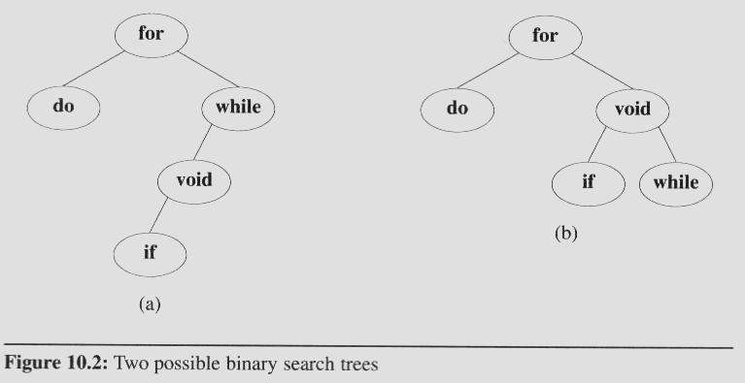
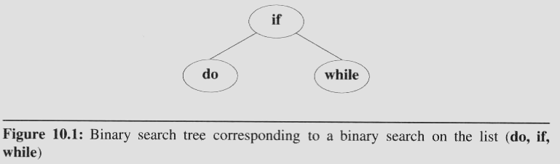
Optimal binary search trees
A full binary tree may not be an optimal binary search tree if the identifiers are searched for with different frequency
Consider these two search trees, If we search for each identifier with equal
Probability
In first tree (a)
the average number of comparisons for successful search is 2.4.
Comparisons for second tree is 2.2.
The second tree (b) has
a better worst case search time than the first tree.
a better average behavior.
(1+2+2+3+4)/5 = 2.4
(1+2+2+3+3)/5 = 2.2

Slide 60
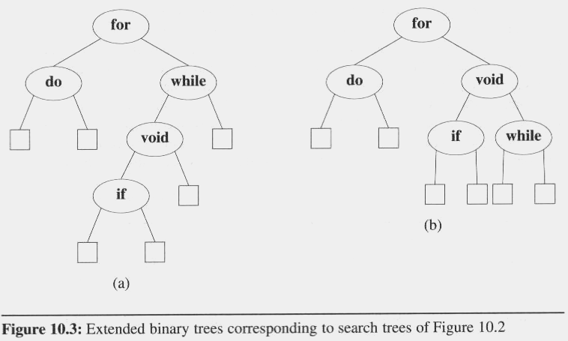
Optimal binary search trees
In evaluating binary search trees, it is useful to add a special square node at every place there is a null links.
We call these nodes external nodes.
We also refer to the external nodes as failure nodes.
The remaining nodes are internal nodes.
A binary tree with external nodes added is an extended binary tree

Slide 61
Optimal binary search trees
External / internal path length
The sum of all external / internal nodes’ levels.
For example
Internal path length, I, is:
I = 0 + 1 + 1 + 2 + 3 = 7
External path length, E, is :
E = 2 + 2 + 4 + 4 + 3 + 2 = 17
A binary tree with n internal nodes are related
by the formula : E = I + 2n
0
1
1
2
2
2
2
3
3
4
4

Slide 62
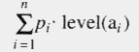
Optimal binary search trees
In the binary search tree:
The identifiers a₁, a₂, …, a_{n} with a₁ < a₂ < … < a_{n}
The probability of searching for each a_{i} is p_{i}
The total cost (when only successful searches are made) is:

Slide 63
Optimal binary search trees
If we replace the null subtree by a failure node, we may partition the identifiers that are not in the binary search tree into n+1 classes E_{i}, 0 ≤ i ≤ n
E_{i} contains all identifiers x such that a_{i} < x < a_{i+1}
For all identifiers in a particular class, E_{i}, the search terminates at the same failure node

Slide 64
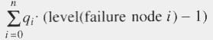
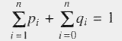
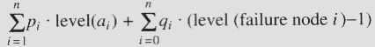
Optimal binary search trees
We number the failure nodes from 0 to n with i being for class E_{i}, 0 ≤ i ≤ n.
If q_{i} is the probability that the identifier we are searching for is in E_{i}, then the cost of the failure node is:
Therefore, the total cost of a binary search tree is:
An optimal binary search tree for the identifier set a₁, …, a_{n} is one that minimizes
Since all searches must terminate either successfully or unsuccessfully, we have

Slide 65
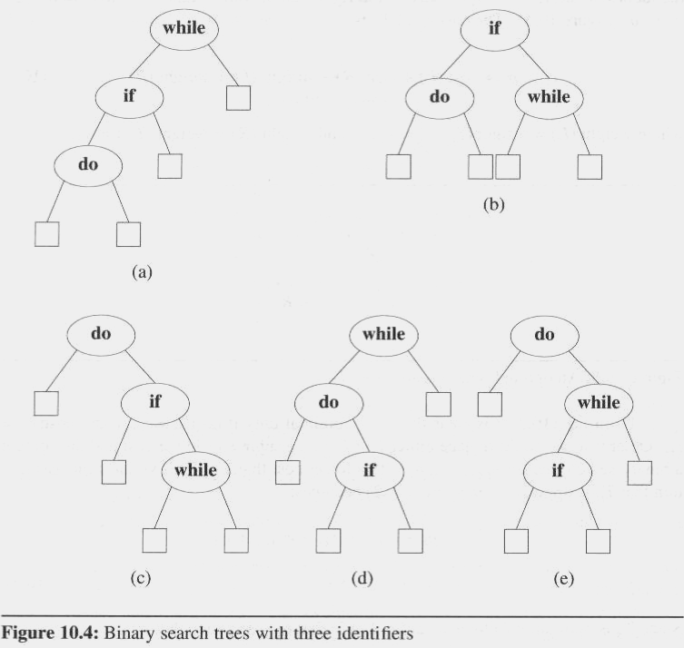
Optimal binary search trees
The possible binary search trees for the identifier set (a₁, a₂, a₃) = (do, if, while)
The identifiers with equal probabilities, p_{i}=q_{j}=1/7 for all i, j,
cost(tree a) = 15/7;
cost(tree b) = 13/7; (optimal)
cost(tree c) = 15/7;
cost(tree d) = 15/7;
cost(tree e) = 15/7;
p₁ = 0.5, p₂ = 0.1, p₃ = 0.05, q₀ = 0.15, q₁= 0.1, q₂ = 0.05, q₃ = 0.05
cost(tree a) = 2.65;
cost(tree b) = 1.9;
cost(tree c) = 1.5; (optimal)
cost(tree d) = 2.05;
cost(tree e) = 1.6;

Slide 66
OPTIMAL BINARY SEARCH TREES (Continued)
With equal probability P(i)=Q(i)=1/7.
Let us find an OBST out of these.
Cost(tree a)=∑P(i)*level a(i) +∑Q(i)*level (Ei) -1
1≤i≤n 0≤i≤n
(2-1) (3-1) (4-1) (4-1)
=1/7[1+2+3 + 1 + 2 + 3 + 3 ] = 15/7
Cost (tree b) =17[1+2+2+2+2+2+2] =13/7
Cost (tree c) =cost (tree d) =cost (tree e) =15/7
∴ tree b is optimal.

Slide 67
OPTIMAL BINARY SEARCH TREES (Continued)
If P(1) =0.5 ,P(2) =0.1, P(3) =0.005 , Q(0) =.15 , Q(1) =.1, Q(2) =.05 and Q(3) =.05 find the OBST.
Cost (tree a) = .5 × 3 +.1 × 2 + .05 × 3 +.15 × 3 + .1 × 3 + .05 × 2 + .05 × 1 = 2.65
Cost (tree b) =1.9 , Cost (tree c) =1.5 ,Cost (tree d) =2.05 ,
Cost (tree e) =1.6 Hence tree C is optimal.

Slide 68
Binary Search Tree - Worst Time
Worst case running time is O(N)
What happens when you Insert elements in ascending order?
Insert: 2, 4, 6, 8, 10, 12 into an empty BST
Problem: Lack of “balance”:
compare depths of left and right subtree
Unbalanced degenerate tree

Slide 69
Balanced and unbalanced BST
1
4
2
2
5
3
1
3
4
4
Is this “balanced”?
5
2
6
6
1
3
5
7
7

Slide 70
Balancing Binary Search Trees
Many algorithms exist for keeping binary search trees balanced
Adelson-Velskii and Landis (AVL) trees (height-balanced trees)
Splay trees and other self-adjusting trees
B-trees and other Multiway search trees

Slide 71
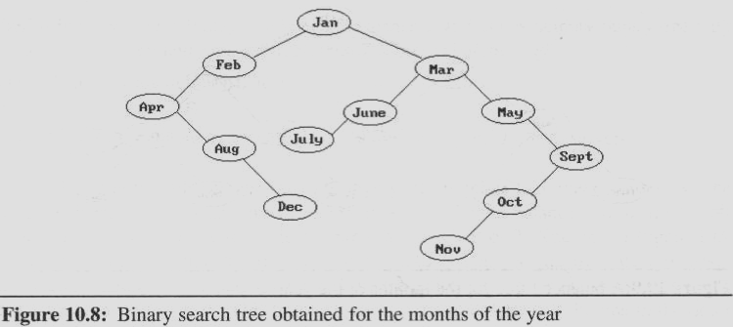
AVL Trees
We also may maintain dynamic tables as binary search trees.
The binary search tree obtained by entering the months January to December, in that order, into an initially empty binary search tree
The maximum number of comparisons needed to search for any identifier in the tree (for November).
Average number of comparisons is 42/12 = 3.5

Slide 72
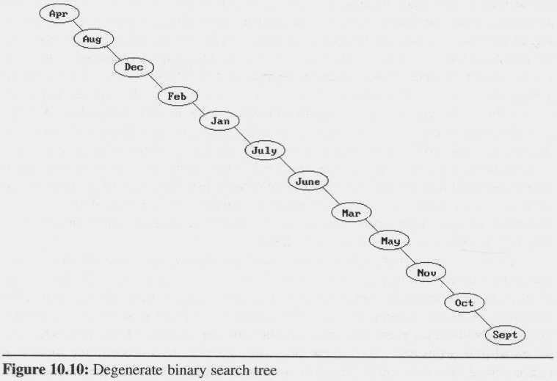
AVL Trees
Suppose that we now enter the months into an initially empty tree in alphabetical order
The tree degenerates into the chain number of comparisons: maximum: 12 and average: 6.5
In the worst case, binary search trees correspond to sequential searching in an ordered list

Slide 73
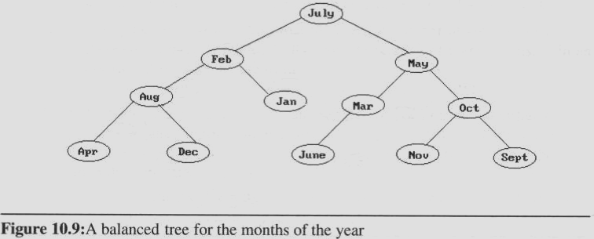
Another insert sequence
In the order Jul, Feb, May, Aug, Jan, Mar, Oct, Apr, Dec, Jun, Nov, and Sep
Well balanced and does not have any paths to leaf nodes that are much longer than others.
Number of comparisons: maximum: 4, and average: 37/12 ≈ 3.1.
All intermediate trees created during the construction of Figure are also well balanced

Slide 74
AVL Trees
Adelson-Velskii and Landis introduced a binary tree structure (AVL trees):
Balanced with respect to the heights of the subtrees.
We can perform dynamic retrievals in O(logn) time for a tree with n nodes.
We can enter an element into the tree, or delete an element from it, in O(logn) time. The resulting tree remain height balanced.
As with binary trees, we may define AVL tree recursively

Slide 75
Perfect Balance
Want a complete tree after every operation
tree is full except possibly in the lower right
This is expensive
For example, insert 2 in the tree on the left and then rebuild as a complete tree
6
5
Insert 2 &
complete tree
4
9
2
8
1
5
8
1
4
6
9

Slide 76
AVL - Good but not Perfect Balance
AVL trees are height-balanced binary search trees
Balance factor of a node
height(left subtree) - height(right subtree)
An AVL tree has balance factor calculated at every node
For every node, heights of left and right subtree can differ by no more than 1
Store current heights in each node

Slide 77
AVL Trees Definition
An empty binary tree is height balanced.
If T is a nonempty binary tree with T_{L} and T_{R} as its left and right subtrees, then T is height balanced iff
T_{L} and T_{R} are height balanced, and
|h_{L} - h_{R}| ≤ 1 where h_{L} and h_{R} are the heights of T_{L} and T_{R}, respectively.
The definition of a height balanced binary tree requires that every subtree also be height balanced

Slide 78
AVL Trees
The numbers by each node represent the difference in heights between the left and right subtrees of that node
We refer to this as the balance factor of the node
Definition:
The balance factor, BF(T), of a node, T, in a binary tree is defined as h_{L} - h_{R}, where h_{L/}h_{R} are the heights of the left/right subtrees of T.
For any node T in an AVL tree BF(T) = -1, 0, or 1.

Slide 79
AVL Trees
We carried out the rebalancing using four different kinds of rotations: LL, RR, LR, and RL
LL and RR are symmetric as are LR and RL
These rotations are characterized by the nearest ancestor, A, of the inserted node, Y, whose balance factor becomes ±2.
LL: Y is inserted in the left subtree of the left subtree of A.
LR: Y is inserted in the right subtree of the left subtree of A
RR: Y is inserted in the right subtree of the right subtree of A
RL: Y is inserted in the left subtree of the right subtree of A

Slide 80
Insertions in AVL Trees
Let the node that needs rebalancing be α.
There are 4 cases:
Outside Cases (require single rotation) :
1. Insertion into left subtree of left child of α.
2. Insertion into right subtree of right child of α.
Inside Cases (require double rotation) :
3. Insertion into right subtree of left child of α.
4. Insertion into left subtree of right child of α.
The rebalancing is performed through four separate rotation algorithms.

Slide 81
AVL Rotations
To perform rotations identify specific node A whose BF(A) is neither ( 0, 1, -1 ).
LL : Inserted node is in the left subtree of left subtree of node A. (SINGLE RIGHT ROTATION)
RR : Inserted node is in the right subtree of right subtree of node A. (SINGLE LEFT ROTATION)
LR : Inserted node is in the right subtree of left subtree of node A. (RR + LL)
RL : Inserted node is in the left subtree of right subtree of node A. (LL + RR)

Slide 82
AVL Balancing : Four Rotations
A
A
C
Double right
B
B
B
Single right
B
A
C
C
C
A
LL
LR
A
A
C
B
Single left
Double left
B
B
A
C
A
B
C
C
RL
RR

Slide 83
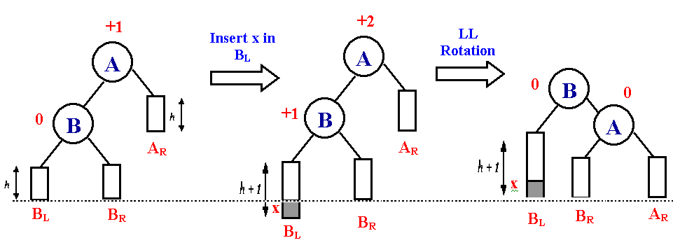
LL Rotations
Balanced AVL
tree
Unbalanced AVL
tree
Balanced AVL
Tree after
ROTATION
B_{L} : Left subtree of B
B_{R} : Right subtree of B
A_{R} : Right subtree of A
h : Height

Slide 84
LL Rotation
-1
-1
1
0
0
0
2
0
1
0
0
0
1
0
1
0
0
0
0
0
0
0
simple right rotation required

Slide 85
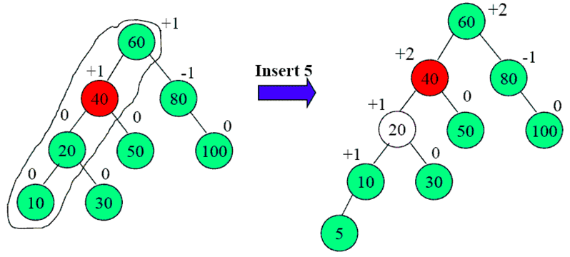
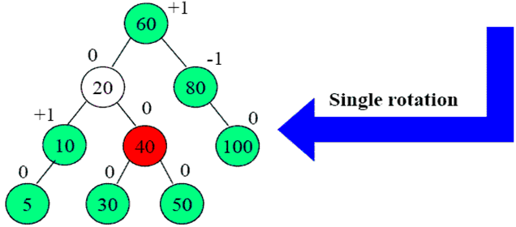
LL Rotation
LL

Slide 86
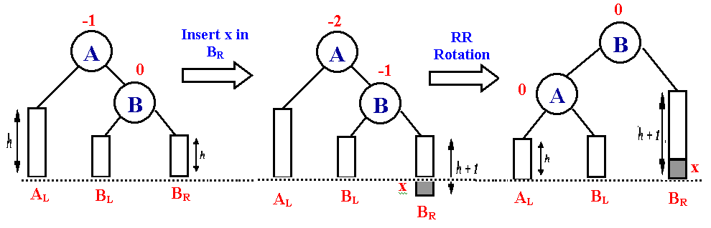
RR Rotations
Balanced AVL
tree
Unbalanced AVL
tree
Balanced AVL
Tree after
ROTATION

Slide 87
RR Rotation
200
100
-1
0
-2
100
235
0
0
200
0
90
-1
-1
175
90
175
239
0
0
1
0
235
0
1
0
-1
-1
85
95
85
215
0
0
0
239
0
0
0
0
-1
105
215
95
105
251
0
251
simple left rotation required

Slide 88
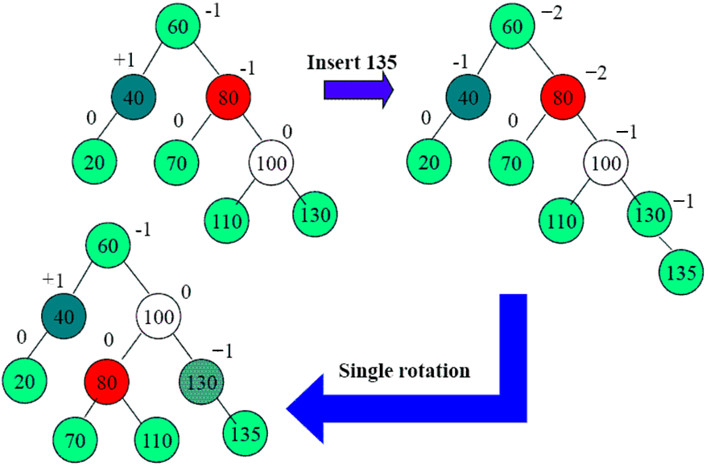
RR Rotation
RR

Slide 89
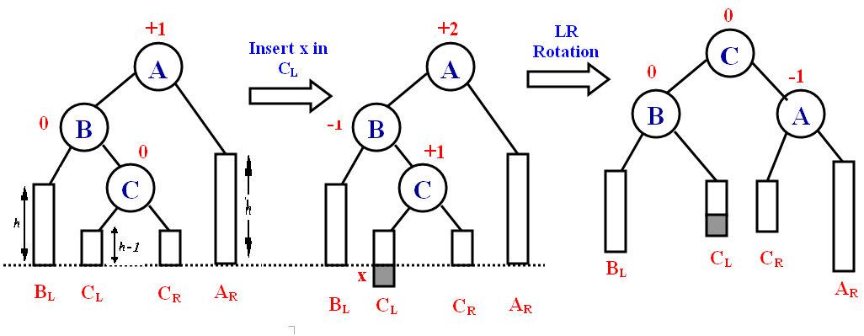
LR Rotations
Balanced AVL
tree
Unbalanced AVL
tree
Balanced AVL
Tree after
ROTATION

Slide 90
Double rotation, step 1
Examples
15
8
17
4
10
16
3
6
5
15
8
17
6
10
16
4
3
5

Slide 91
Double rotation, step 2
15
8
17
6
10
16
4
3
5
15
6
17
4
8
16
3
5
10

Slide 92
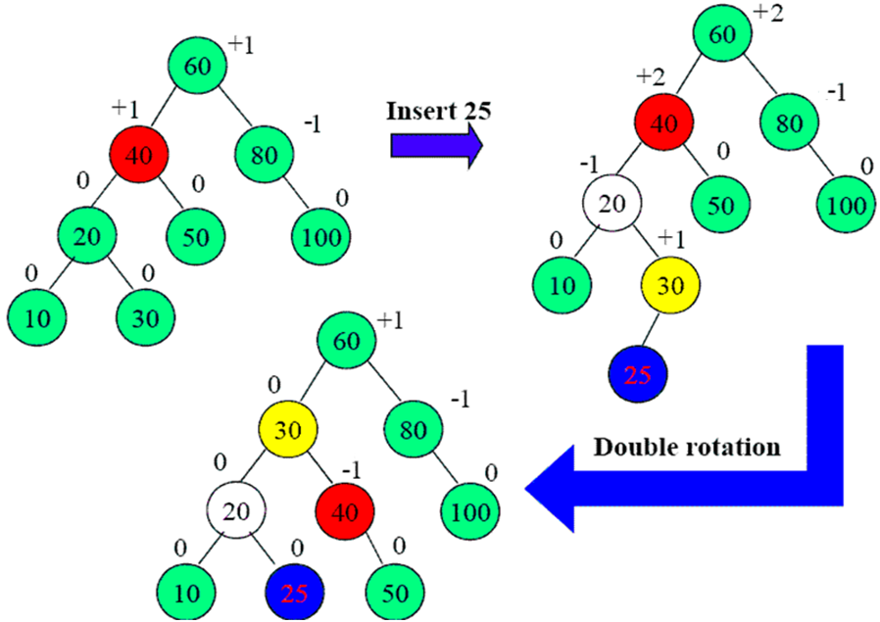
Example 1
LR

Slide 93
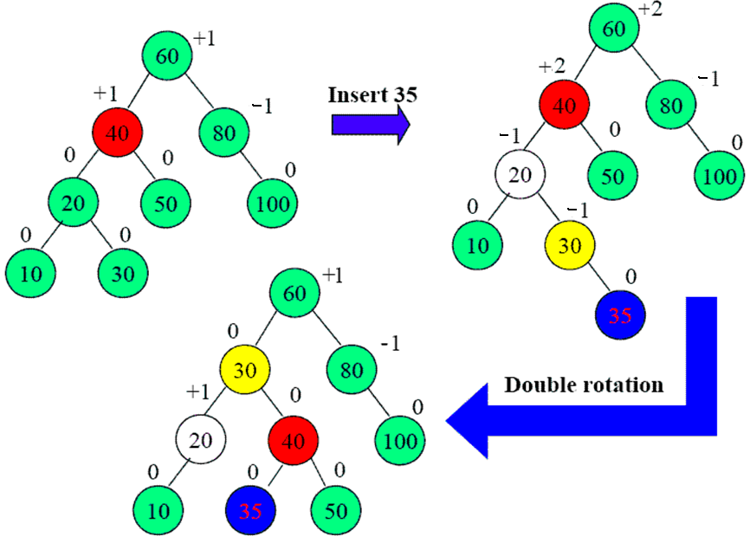
Example 2
LR

Slide 94
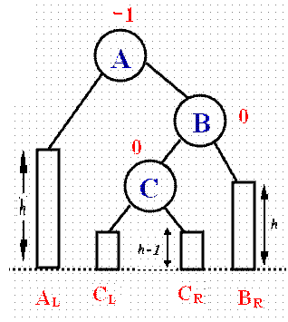
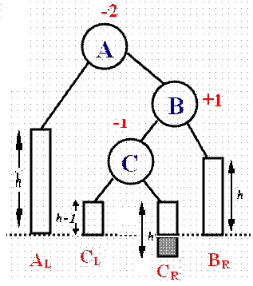
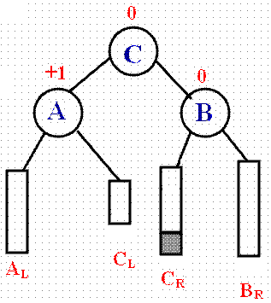
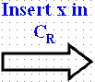
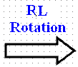
RL Rotations
Balanced AVL
tree
Unbalanced AVL
tree
Balanced AVL
Tree after
ROTATION

Slide 95
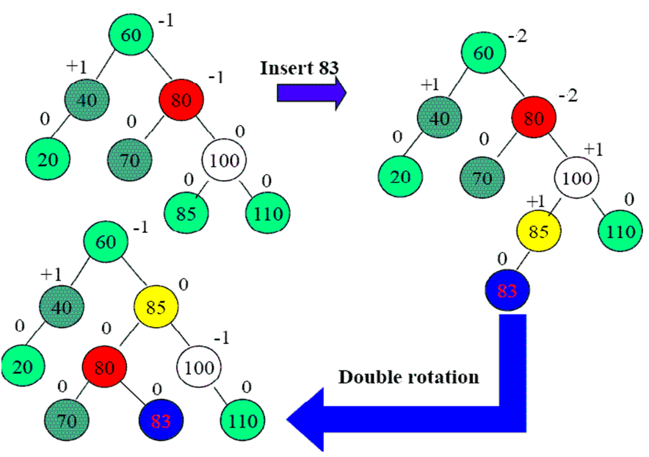
Example 1
RL

Slide 96
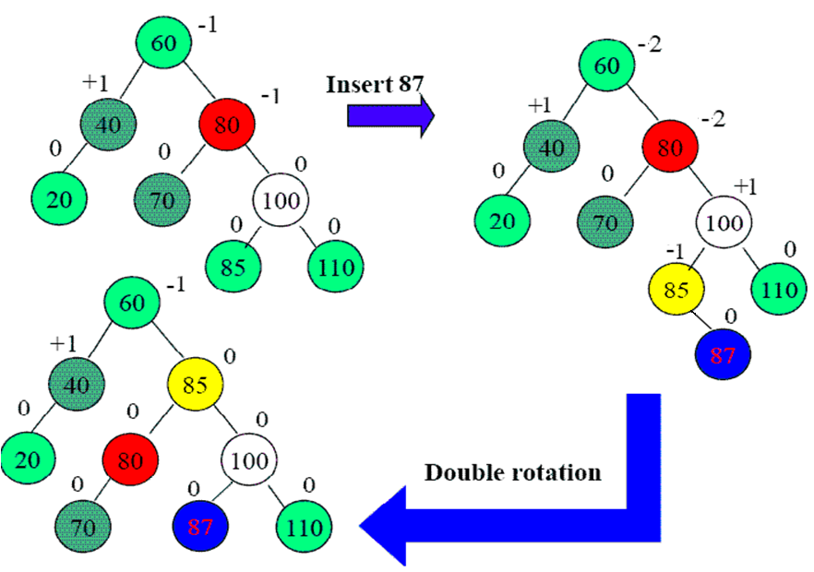
Example 2
RL

Slide 97
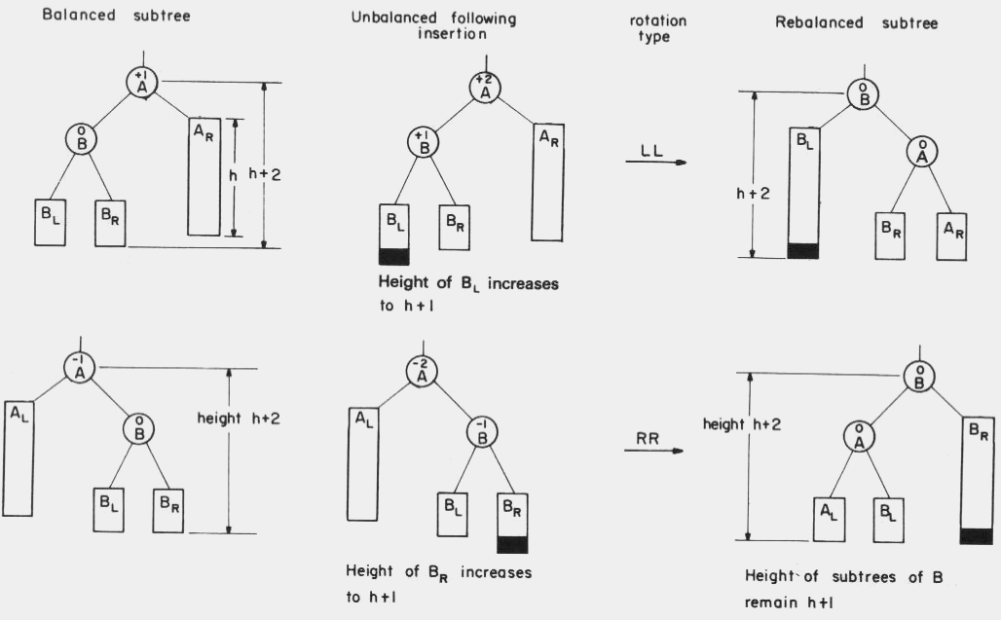
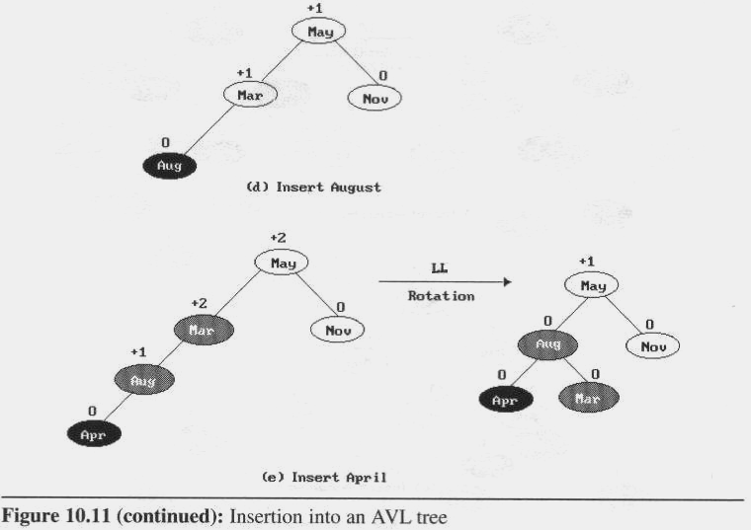
Rebalancing rotations

Slide 98
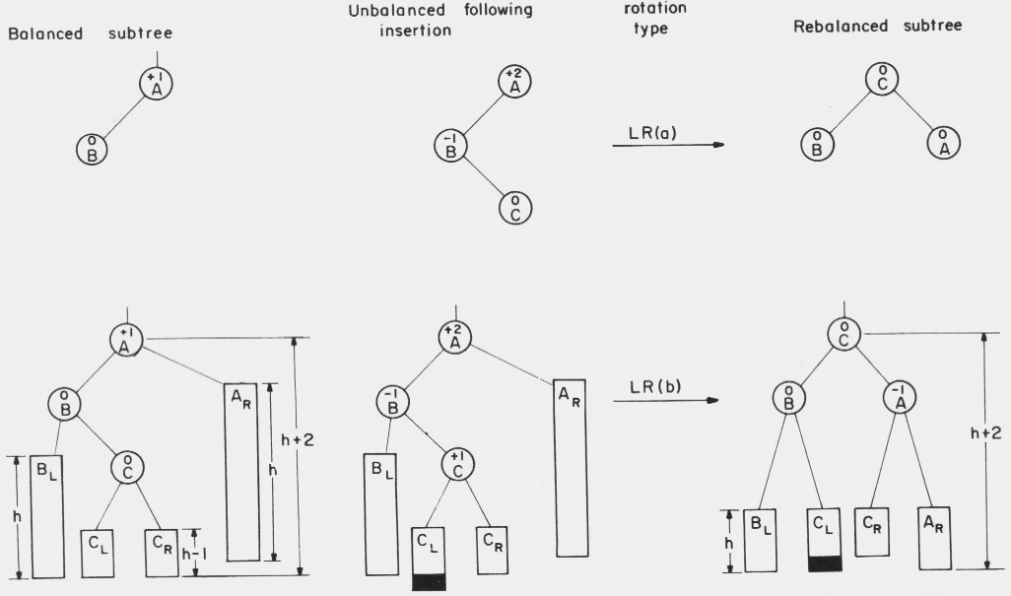
AVL Trees
Rebalancing rotations (cont’d)

Slide 99
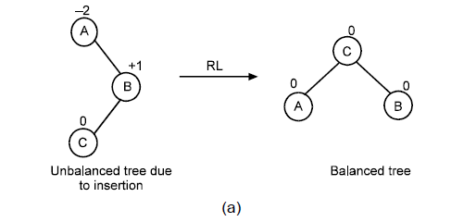
Case 4: RL (Left of Right)

Slide 100
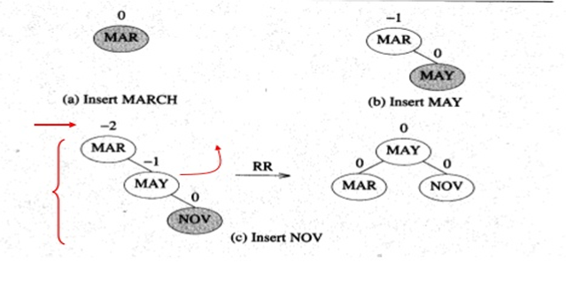
This time we will insert the months into the tree in the order
Mar, May, Nov, Aug, Apr, Jan, Dec, Jul, Feb, Jun, Oct, Sep
It shows the tree as it grows, and the restructuring involved in keeping it balanced.

Slide 101
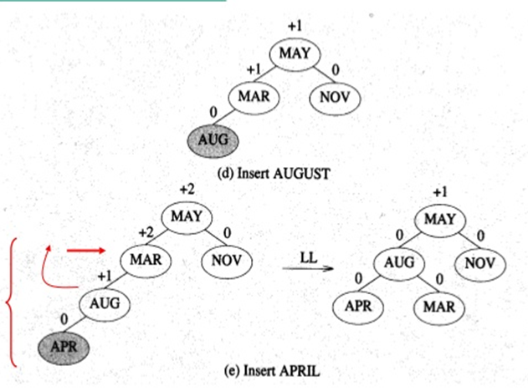
This time we will insert the months into the tree in the order
Mar, May, Nov, Aug, Apr, Jan, Dec, Jul, Feb, Jun, Oct, Sep
It shows the tree as it grows, and the restructuring involved in keeping it balanced.

Slide 102
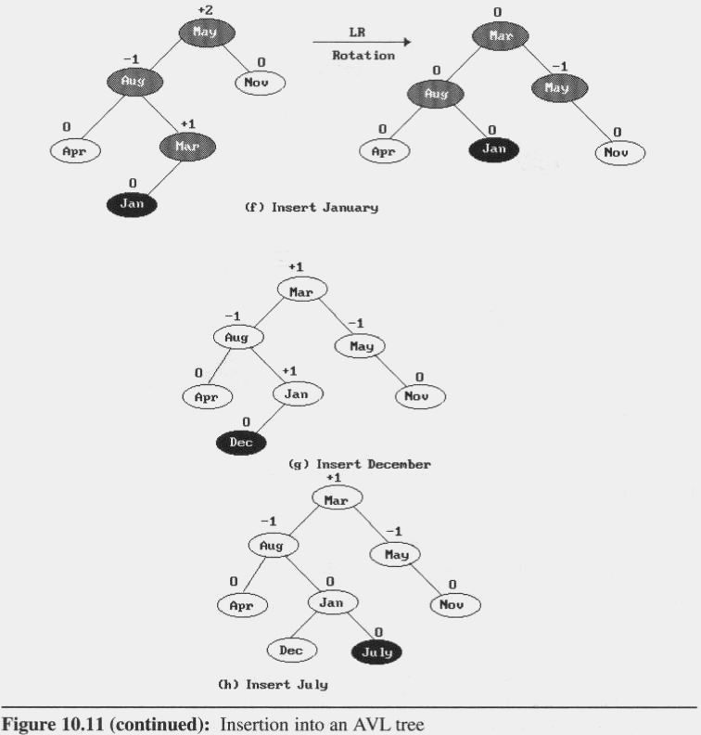
Rebalancing rotations (cont’d)

Slide 103
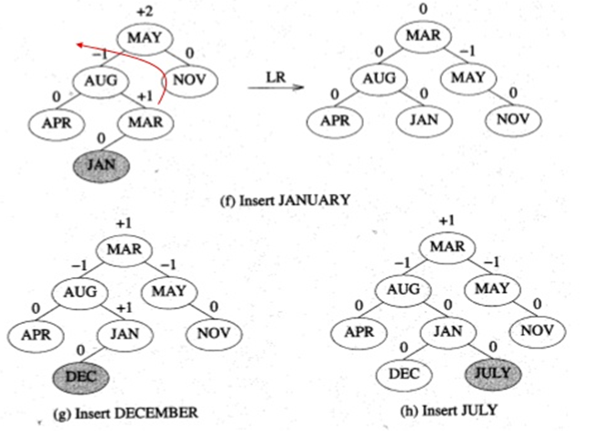

Slide 104
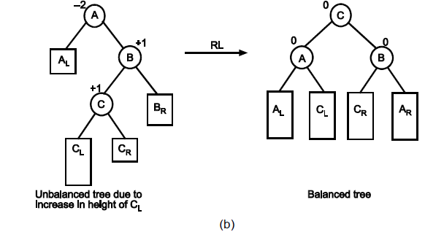
Case 4: RL(Left of Right)

Slide 105
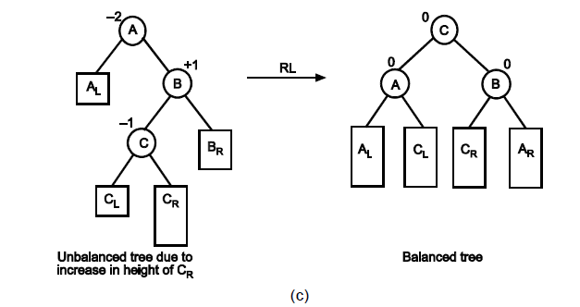
Case 4: RL (Left of Right)

Slide 106
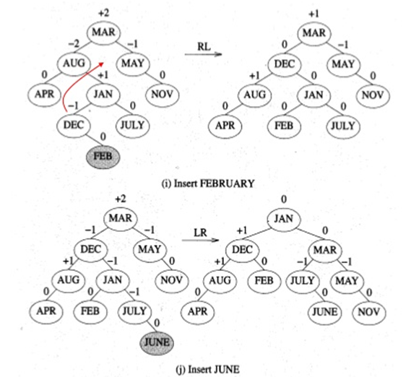

Slide 107
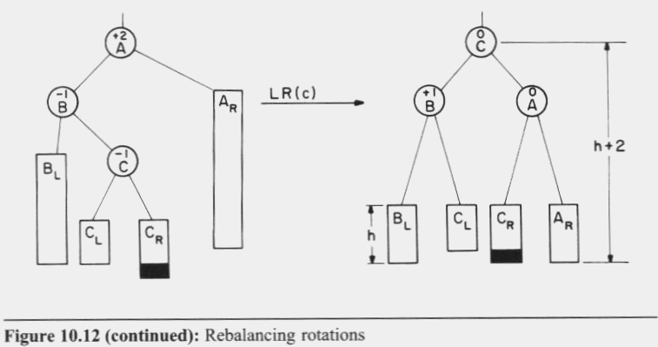
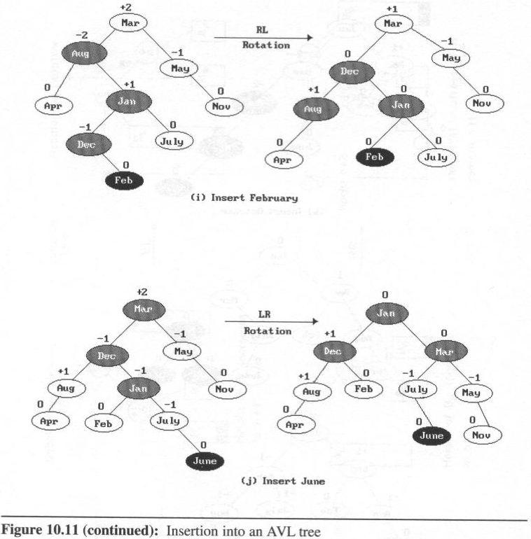
Case 3: LR (Left of Right )

Slide 108
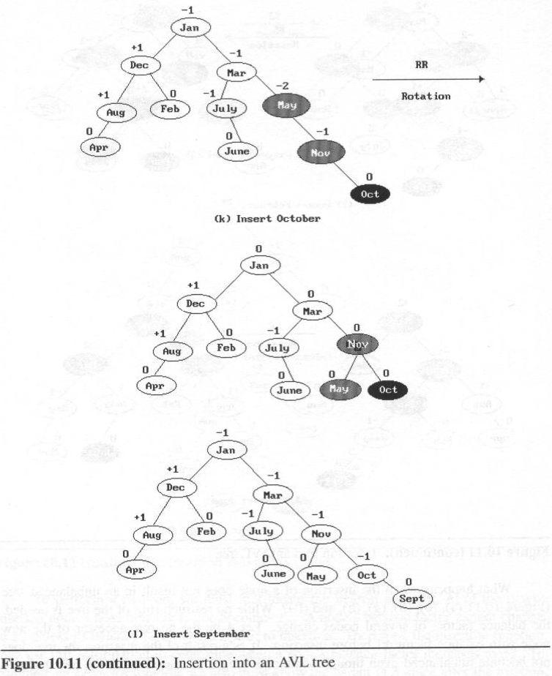
AVL Trees

Slide 109
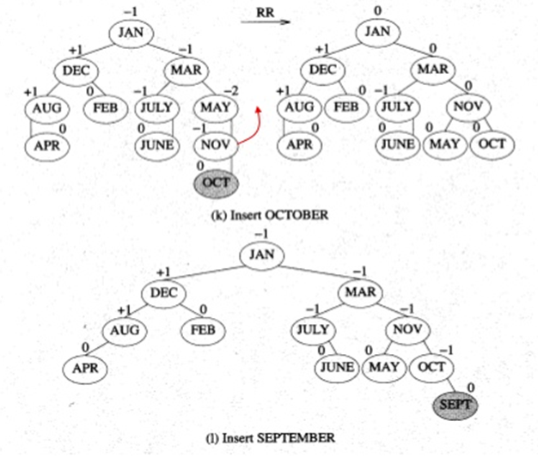

Slide 110
class avlTree
{ avl_node *root;
public:
int height(avl_node *);
int diff(avl_node *);
avl_node *rr_rotation(avl_node *);
avl_node *ll_rotation(avl_node *);
avl_node *lr_rotation(avl_node *);
avl_node *rl_rotation(avl_node *);
avl_node* balance(avl_node *);
avl_node* insert();
avl_node* insert(avl_node *, avl_node *);
void display(avl_node *, int);
void inorder(avl_node *);
void preorder(avl_node *);
void postorder(avl_node *);
avlTree()
{
root = NULL;
}
};
Node Structure for AVL Tree
class avl_node
{
int value;
string word, meaning;
avl_node *left, *right;
public:
friend class avlTree;
};

Slide 111
LL Rotation
parent
avl_node* avlTree:: LL_rotation (avl_node *parent)
{
avl_node * temp = parent->left;
parent->left = temp->right;
temp->right = parent;
return temp;
}
temp
return address

Slide 112
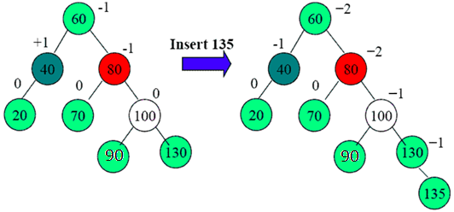
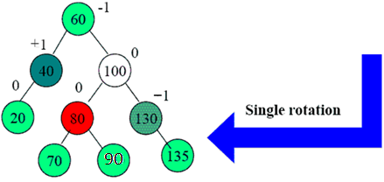
RR Rotation
avl_node* avlTree:: RR_rotation (avl_node *parent)
{
avl_node* temp = parent->right;
parent->right = temp->left;
temp->left = parent;
return temp;
}
parent
temp
return address

Slide 113
LR Rotation
parent
temp
return address
avl_node* avlTree:: LR_rotation (avl_node *parent)
{
avl_node *temp = parent->left;
parent->left = RR_rotation (temp); //calling RR rotation
return LL_rotation (parent);
// return root after LL rotation
}

Slide 114
parent
RL Rotation
temp
return address
avl_node* avlTree:: RL_rotation (avl_node *parent)
{
avl_node *temp = parent->right;
parent->right = LL_rotation (temp); // calling LL rotation
return RR_rotation (parent);
// return root after RR rotation
}

Slide 115
int avlTree::diff(avl_node *temp)
{
int l_height = height (temp->left);
int r_height = height (temp->right);
int b_factor= l_height - r_height;
return b_factor;
}
int avlTree::height(avl_node *temp)
{
int h = 0;
if (temp != NULL)
{
int l_height = height (temp->left);
int r_height = height (temp->right);
int max_height = max (l_height, r_height);
h = max_height + 1;
}
return h;
}
-1
2
0
0
1
7
0
5
8
0

Slide 116
avl_node* avlTree:: balance(avl_node *temp)
{
int bal_factor = diff (temp);
if (bal_factor > 1)
{
if (diff (temp->left) > 0)
temp = LL_rotation (temp);
else
temp = LR_rotation (temp);
}
else if (bal_factor < -1)
{
if (diff (temp->right) > 0)
temp = RL_rotation (temp);
else
temp = RR_rotation (temp);
}
return temp;
}

Slide 117
void avlTree::insert() //workhorse to insert
{
char ch;
do
{
avl_node *temp;
cout<<“Enter word and it’s meaning”;
cin>>temp->word>>temp->meaning;
root=insert(root, temp);
cout<<“Enter your choice”;
cin>>ch;
}while(ch == ‘Y’);
}

Slide 118
avl_node* avlTree:: insert( avl_node *root, avl_node *temp)
{
if (root == NULL)
{
root = new avl_node;
root->word= temp->word;
root->meaning= temp->meaning;
root->left = NULL;
root->right = NULL;
return root;
}
else if (temp->word< root->data)
{
root->left = insert(root->left, temp);
root = balance (root);
}
else if (temp->word >= root->data)
{
root->right = insert(root->right, temp);
root = balance (root);
}
return root;
}
Insert 9
-2
2
0
-1
1
7
0
5
8
-1
9
0

Slide 119
Algorithm display (node *ptr, int level) // consider level =1
{
if (ptr!=NULL)
{ display(ptr->right, level + 1);
printf("\n");
if (ptr == root)
cout<<"Root -> ";
for (i = 0; i < level && ptr != root; i++)
cout<<" ";
cout<<ptr->data;
display(ptr->left, level + 1);
}
}

Slide 120
Splay Tree

Slide 121
Introduction
Splay tree is another variant of binary search tree. In a splay tree, the recently accessed element is placed at the root of the tree. A splay tree is defined as follows..
Splay Tree is a self - adjusted Binary Search Tree in which every operation on an element rearrange the tree so that the element is placed at the root position of the tree.
In a splay tree, every operation is performed at root of the tree. All the operations on a splay tree are involved with a common operation called "Splaying".
Splaying an element is the process of bringing it to the root position by performing suitable rotation operations.
In a splay tree, splaying an element is rearranging all the elements in the tree so that splayed element is placed at root of the tree.
With the help of splaying an element we can bring most frequently used element closer to the root of the tree so that any operation on those element is performed quickly. That means the splaying operation automatically brings more frequently used elements closer to the root of the tree.

Slide 122
Introduction
Every operation on a splay tree performs the splaying operation.
For example, the insertion operation first inserts the new element as it is inserted into the binary search tree, after insertion the newly inserted element is splayed so that it is placed at root of the tree.
The search operation in a splay tree is searching the element using binary search process and then splay the searched element so that it placed at the root of the tree.
Every Splay tree must be a binary search tree but it is need not be balanced tree.

Slide 123
Rotations in Splay Tree
1. Zig Rotation
2. Zag Rotation
3. Zig - Zig Rotation
4. Zag - Zag Rotation
5. Zig - Zag Rotation
6. Zag - Zig Rotation

Slide 124
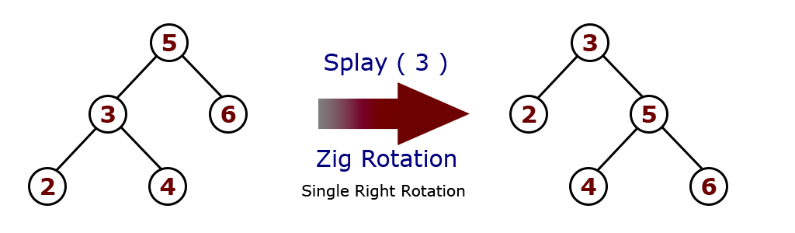
Zig Rotation
The Zig Rotation in a splay tree is similar to the single right rotation in AVL Tree rotations.
In zig rotation every node moves one position to the right from its current position.

Slide 125
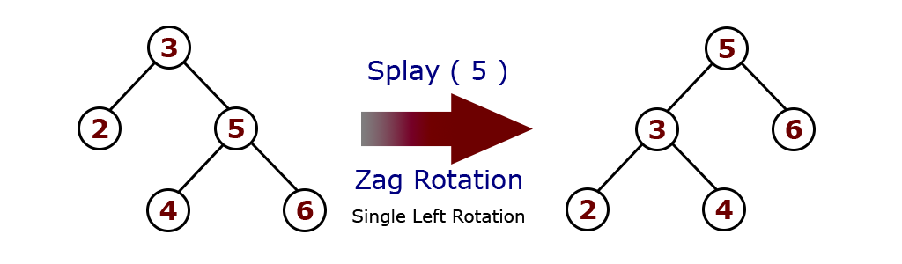
Zag Rotation
The Zag Rotation in a splay tree is similar to the single left rotation in AVL Tree rotations.
In zag rotation every node moves one position to the left from its current position

Slide 126
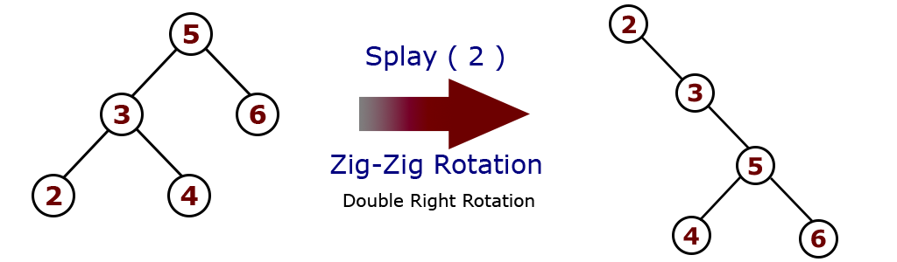
Zig-Zig Rotation
The Zig-Zig Rotation in a splay tree is a double zig rotation.
In zig-zig rotation every node moves two position to the right from its current position.

Slide 127
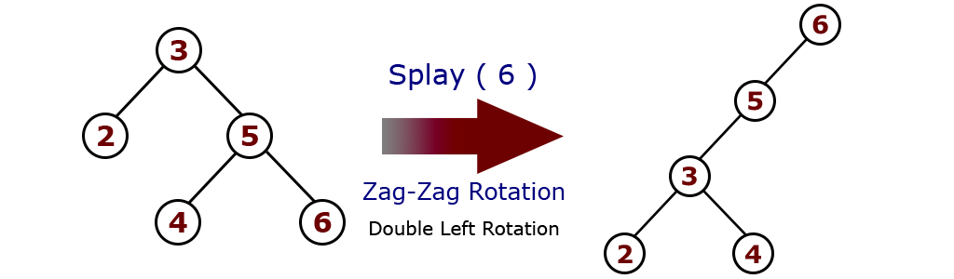
Zag-Zag Rotation
The Zag-Zag Rotation in a splay tree is a double zag rotation. In zag-zag rotation every node moves two position to the left from its current position.

Slide 128
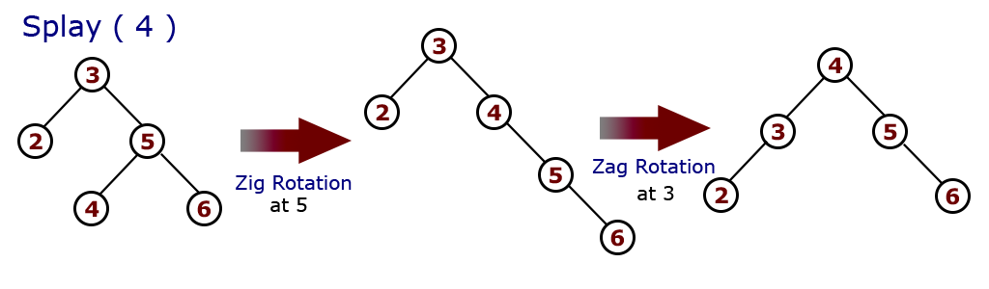
Zig-Zag Rotation
The Zig-Zag Rotation in a splay tree is a sequence of zig rotation followed by zag rotation.
In zig-zag rotation every node moves one position to the right followed by one position to the left from its current position.

Slide 129

Zag-Zig Rotation
The Zag-Zig Rotation in a splay tree is a sequence of zag rotation followed by zig rotation.
In zag-zig rotation every node moves one position to the left followed by one position to the right from its current position.

Slide 130
Insertion Operation in Splay Tree
The insertion operation in Splay tree is performed using following steps...
Step 1: Check whether tree is Empty.
Step 2: If tree is Empty then insert the newNode as Root node and exit from the operation.
step 3: If tree is not Empty then insert the newNode as a leaf node using Binary Search tree insertion logic.
Step 4: After insertion, Splay the newNode

Slide 131
Original tree
10

Slide 132
After insert key 15
10
15

Slide 133
After splaying
15
10

Slide 134
After insert key 12
15
10
12

Slide 135
After splaying
12
15
10

Slide 136
Deletion Operation in Splay Tree
Before deleting the element first we need to splay that node then delete it from the root position then join the remaining tree.
The tree is split into two trees, the left subtree (Root_left) and the right subtree (Root_right)
If Root_left is a NULL value, then the Root_right will become the root of the tree. And vice versa.
But if both Root_left and Root_right are not NULL values, then select the maximum value from the left subtree and make it the new root by connecting the subtrees.

Slide 137
Deletion Operation in Splay Tree
If Root_left is a NULL value, then the Root_right will become the root of the tree. And vice versa.
Root_left
Root_right = NULL
Final Root

Slide 138
Deletion Operation in Splay Tree
Root_left
Root_right
Both Root_left and Root_right are not NULL values, then select the maximum value from the left subtree and make it the new root by connecting the subtrees.
4
3
6
2

Slide 139
Red-black trees: Overview
Red-black trees are a variation of binary search trees to ensure that the tree is balanced.
Height is O(log n), where n is the number of nodes.
Operations take O(log n) time in the worst case.

Slide 140
Red-black Tree
Binary search tree + 1 bit per node: the attribute color, which is either red or black.
All other attributes of BSTs are inherited:
key, left, right, and p.
All empty trees (leaves) are colored black.
We use a single sentinel, nil, for all the leaves of red-black tree T, with color[nil] = black.
The root’s parent is also nil[T ].

Slide 141
Why Red-Black Trees?
Most of the BST operations (e.g., search, max, min, insert, delete.. etc) take O(h) time where h is the height of the BST.
The cost of these operations may become O(n) for a skewed Binary tree.
If we make sure that height of the tree remains O(logn) after every insertion and deletion, then we can guarantee an upper bound of O(logn) for all these operations.
The height of a Red Black tree is always O(logn) where n is the number of nodes in the tree.

Slide 142
Comparison with AVL Tree
The AVL trees are more balanced compared to Red Black Trees, but they may cause more rotations during insertion and deletion.
So if your application involves many frequent insertions and deletions, then Red Black trees should be preferred.
And if the insertions and deletions are less frequent and search is more frequent operation, then AVL tree should be preferred over Red Black Tree.

Slide 143
Red-black Properties
Every node is either red or black.
The root is black.
Every leaf (nil) is black.
If a node is red, then both its children are black.
For each node, all paths from the node to descendant leaves contain the same number of black nodes.

Slide 144
Black-Height of a Node
h = 4
bh = 2
26
h = 1
bh = 1
h = 3
bh = 2
17
41
NIL
NIL
h = 2
bh = 1
h = 2
bh = 1
30
47
h = 1
bh = 1
38
50
h = 1
bh = 1
NIL
NIL
NIL
NIL
NIL
NIL
Height of a node: the number of edges in the longest path to a leaf
Black-height of a node x: bh(x) is the number of black nodes (including NIL) on the path from x to a leaf, not counting x

Slide 145
Case 1 – uncle y is red
p[p[z]]
p[p[z]]
new z
new z
C
C
C
C
p[z]
p[z]
y
y
A
A
D
D
A
A
D
D
z
z
α
α
δ
δ
ε
ε
α
α
δ
δ
ε
B
ε
B
B
B
z is a right child here.
Similar steps if z is a left child.
z is a right child here.
Similar steps if z is a left child.
γ
β
γ
β
γ
β
γ
β
p[p[z]] (z’s grandparent) must be black, since z and p[z] are both red and there are no other violations of property 4.
Make p[z] and y black ⇒ now z and p[z] are not both red. But property 5 might now be violated.
Make p[p[z]] red ⇒ restores property 5.
The next iteration has p[p[z]] as the new z (i.e., z moves up 2 levels).

Slide 146
Case 2a – uncle y is black, p[z] is left child and z is a right child
C
C
p[z]
p[z]
A
δ
y
B
δ
y
z
α
z
A
γ
B
γ
α
β
β
Left rotate around p[z], p[z] and z switch roles ⇒ now z is a left child, and both z and p[z] are red.
Takes us immediately to case 3a.

Slide 147
Case 3a – uncle y is black, z is a left child
C
B
p[z]
B
A
C
δ
y
z
α
β
γ
δ
A
γ
α
β
Make p[z] black and p[p[z]] red.
Then right rotate on p[p[z]]. Ensures property 4 is maintained.
No longer have 2 reds in a row.
p[z] is now black ⇒ no more iterations.

Slide 148
Case 2b – uncle y is black, p[z] is right child and z is a left child
C
C
p[z]
p[z]
A
δ
y
B
δ
y
z
α
z
A
γ
B
α
β
β
γ
Right rotate around p[z], p[z] and z switch roles ⇒ now z is a right child, and both z and p[z] are red.
Takes us immediately to case 3b.

Slide 149
Case 3b – uncle y is black, z is a right child
C
B
p[z]
B
C
A
δ
y
z
δ
γ
α
δ
γ
A
α
β
Make p[z] black and p[p[z]] red.
Then left rotate on p[p[z]]. Ensures property 4 is maintained.
No longer have 2 reds in a row.
p[z] is now black ⇒ no more iterations.

Slide 150
Example
Insert 4
11
Case 1
11
Case 2
2
14
2
14
y
1
7
7
z
15
1
15
5
8
y
5
8
z and p[z] are both red
z’s uncle y is red
z and p[z] are both red
z’s uncle y is black
z is a right child
z
4
4
11
7
Case 3
z
7
14
y
2
11
z
2
8
15
1
5
8
14
1
5
z and p[z] are red
z’s uncle y is black
z is a left child
4
15
4

Slide 151



Slide 152

Problems
What red-black tree property is violated in the tree below? How would you restore the red-black tree property in this case?
Property violated: if a node is red, both its children are black
Fixup: color 7 black, 11 red, then right-rotate around 11
7
z
2
11
1
5
8
14
4
15

